Slide 1
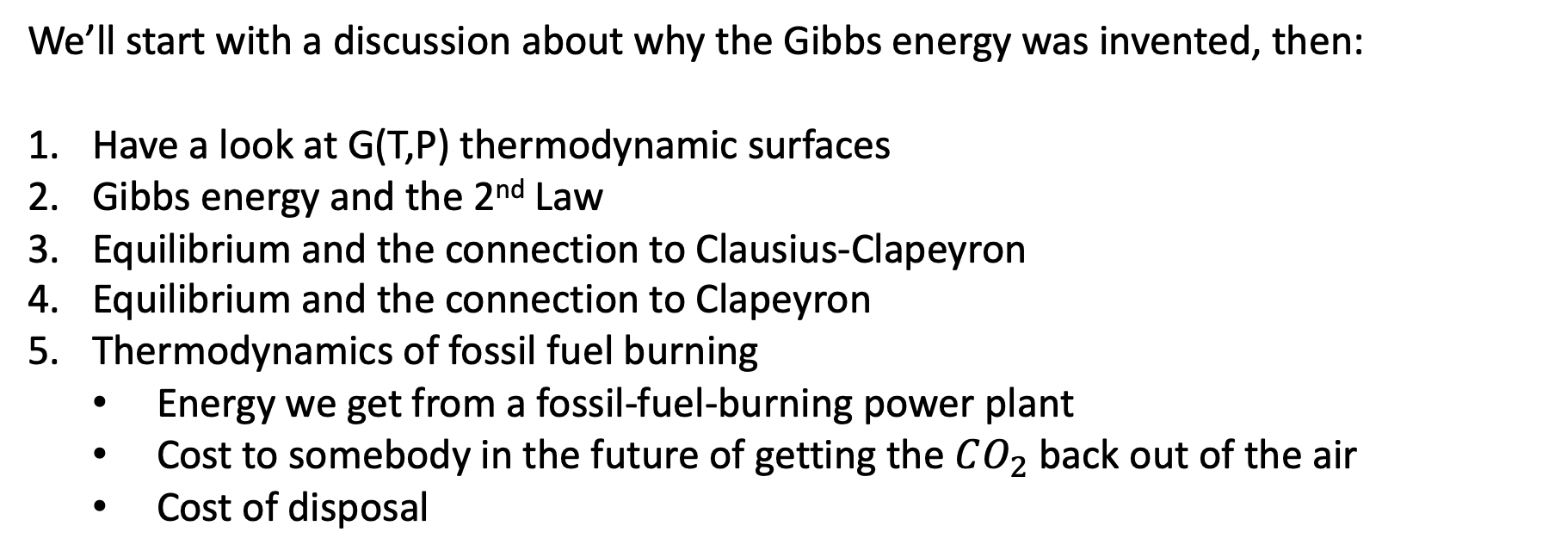
Plan for the day
We’ll start with a discussion about why the Gibbs energy was invented, then:
Have a look at G(T,P) thermodynamic surfaces
Gibbs energy and the 2nd Law
Equilibrium and the connection to Clausius-Clapeyron
Equilibrium and the connection to Clapeyron
Thermodynamics of fossil fuel burning
Energy we get from a fossil-fuel-burning power plant
Cost to somebody in the future of getting the $CO_{2}$ back out of the air
Cost of disposal

Slide 2
Why G was invented
John Hanson says:
“Enthalpy is all about heat”
“Gibbs energy is all about (non-PV) work”
What’s non-PV work? Mitochondria making ATP … ions moving across cell membranes … reverse osmosis … changing concentrations of solutes
We’ll be looking at the last of these later in this lecture, in which one additional idea about Gibbs energy will be used:
The Gibbs energy change associated with an “uphill” (unfavorable) process that takes place at a given temperature and pressure tells us the minimum amount of non-PV work we’d need to drive that process.

Slide 3
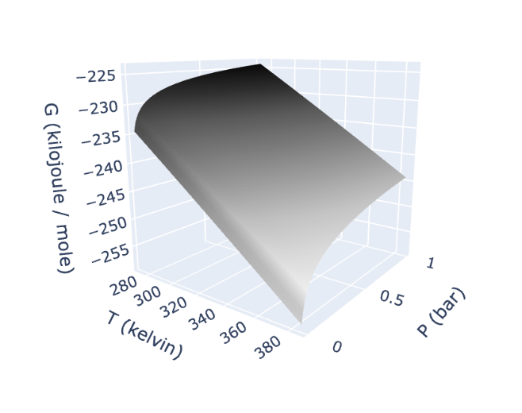
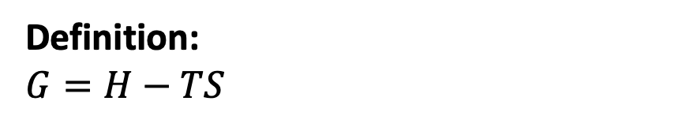
1. G(T,P) thermodynamic surfaces
Definition:
$G=H−TS$
Gas
Why does G slope down in the temperature direction, up in the pressure direction?

Slide 4
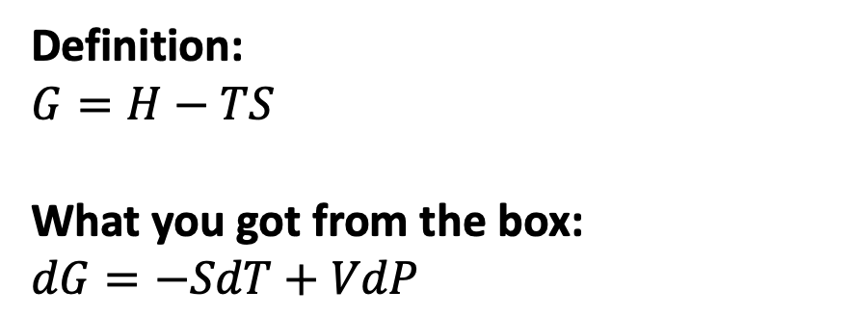
1. G(T,P) thermodynamic surfaces
Definition:
$G=H−TS$
What you got from the box:
$dG=−SdT+VdP$
Gas
Why does G slope down in the temperature direction, up in the pressure direction?

Slide 5
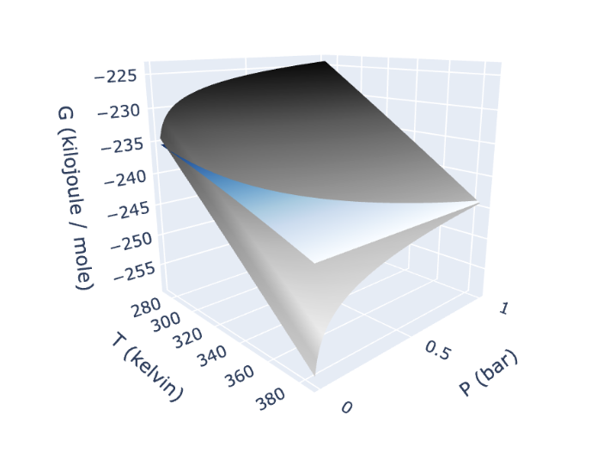
1. G(T,P) thermodynamic surfaces
Definition:
$G=H−TS$
What you got from the box:
$dG=−SdT+VdP$
Liquid
Gas
Why is the gas curve steeper in the temperature direction?

Slide 6

1. G(T,P) thermodynamic surfaces
Definition:
$G=H−TS$
What you got from the box:
$dG=−SdT+VdP$
Liquid
Gas
Why is the gas curve steeper in the temperature direction?
Because $S_{gas}>S_{liq}$

Slide 7
1. G(T,P) thermodynamic surfaces
Definition:
$G=H−TS$
What you got from the box:
$dG=−SdT+VdP$
Liquid
Gas
Why is the gas curve also steeper in the pressure direction?

Slide 8

1. G(T,P) thermodynamic surfaces
Definition:
$G=H−TS$
What you got from the box:
$dG=−SdT+VdP$
Liquid
Gas
Why is the gas curve also steeper in the pressure direction?
Because $V_{gas}>V_{liq}$

Slide 9
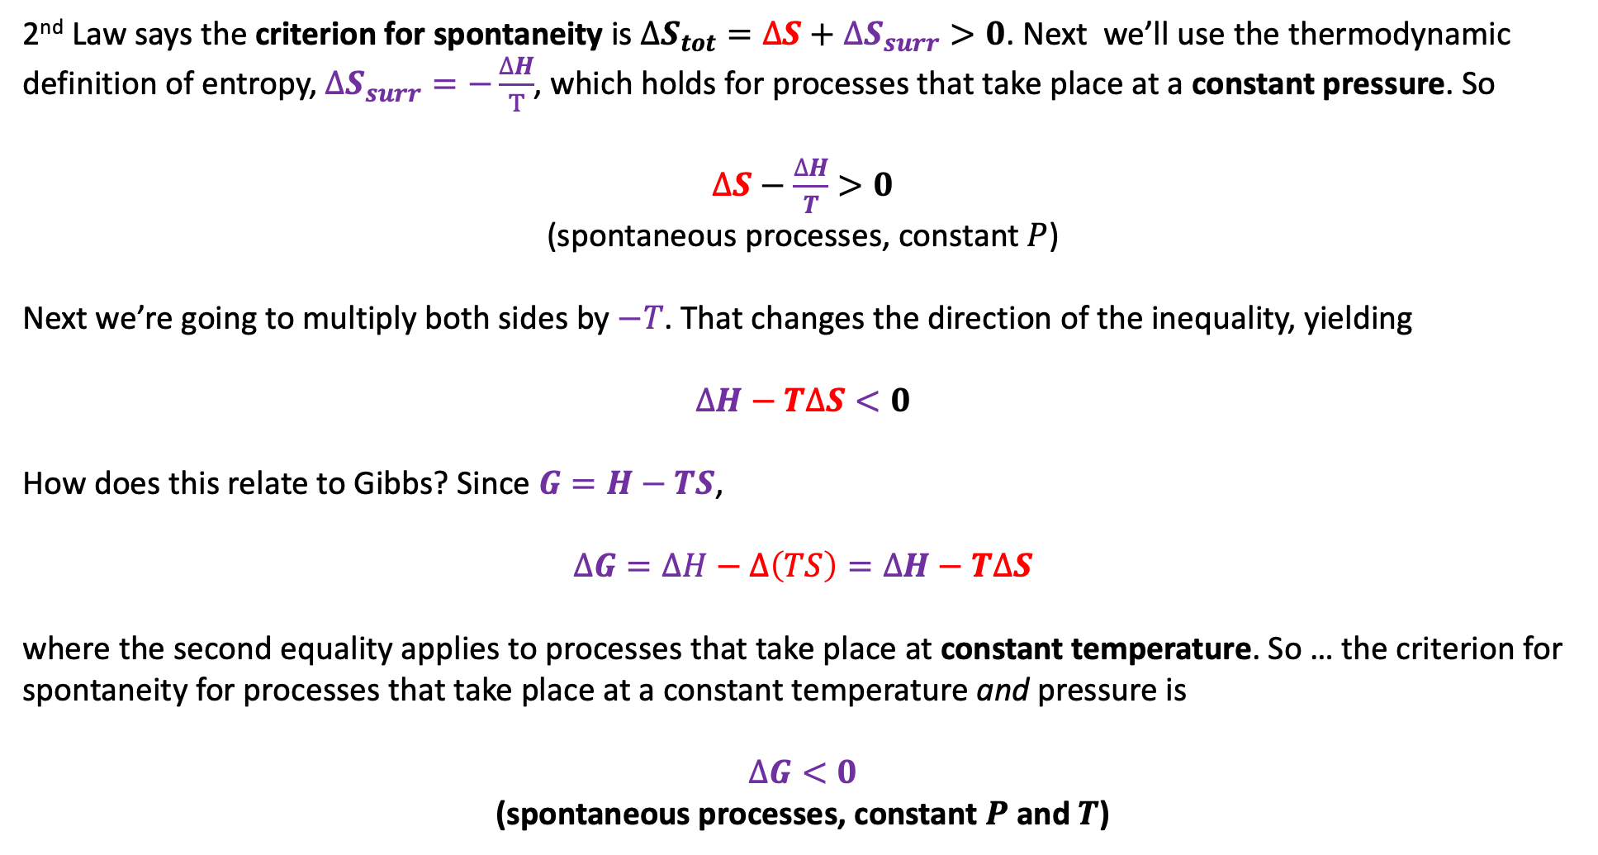
2. G(T,P) thermodynamic surfaces and the 2nd Law
2nd Law says the criterion for spontaneity is $∆S_{tot}=∆S+∆S_{surr}>0$. Next we’ll use the thermodynamic definition of entropy, $∆S_{surr}=−\frac{∆H}{T}$, which holds for processes that take place at a constant pressure. So
$∆S−\frac{∆H}{T}>0$
(spontaneous processes, constant $P$)
Next we’re going to multiply both sides by $−T$. That changes the direction of the inequality, yielding
$$∆H−T∆S<0$$
How does this relate to Gibbs? Since $G=H−TS$,
$$∆G=∆H−∆\left(TS\right)=∆H−T∆S$$
where the second equality applies to processes that take place at constant temperature. So … the criterion for spontaneity for processes that take place at a constant temperature and pressure is
$∆G<0$
(spontaneous processes, constant $P$ and $T$)

Slide 10
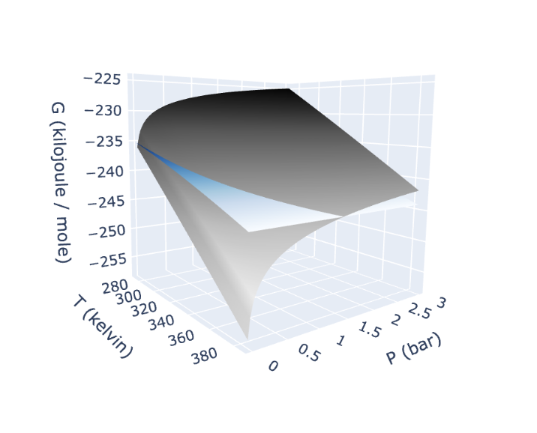
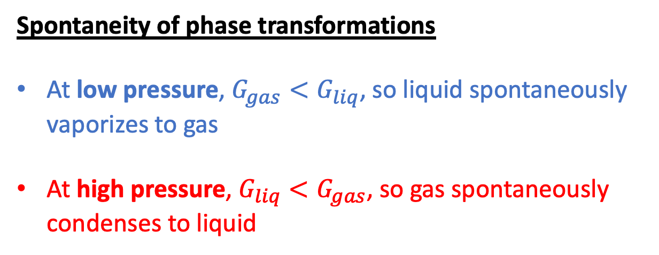
2. G(T,P) thermodynamic surfaces and the 2nd Law
Spontaneity of phase transformations
At low pressure, $G_{gas}<G_{liq}$, so liquid spontaneously vaporizes to gas
At high pressure, $G_{liq}<G_{gas}$, so gas spontaneously condenses to liquid
Liquid
Gas
gas
gas
liquid

Slide 11
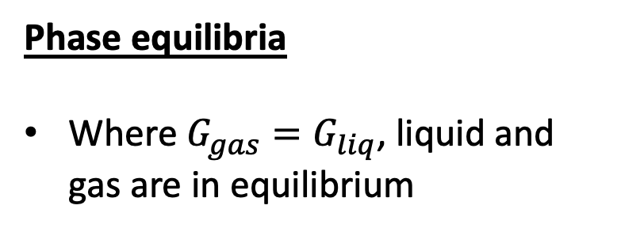
3. Equilibrium and connection to Clausius-Clapeyron
Phase equilibria
Where $G_{gas}=G_{liq}$, liquid and gas are in equilibrium
Liquid
Gas

Slide 12
3. Equilibrium and connection to Clausius-Clapeyron
Phase equilibria
Where $G_{gas}=G_{liq}$, liquid and gas are in equilibrium
Liquid
Gas

Slide 13
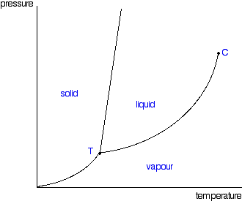
3. Equilibrium and connection to Clausius-Clapeyron
Phase equilibria
Where $G_{gas}=G_{liq}$, liquid and gas are in equilibrium
Liquid
Gas
P
T

Slide 14
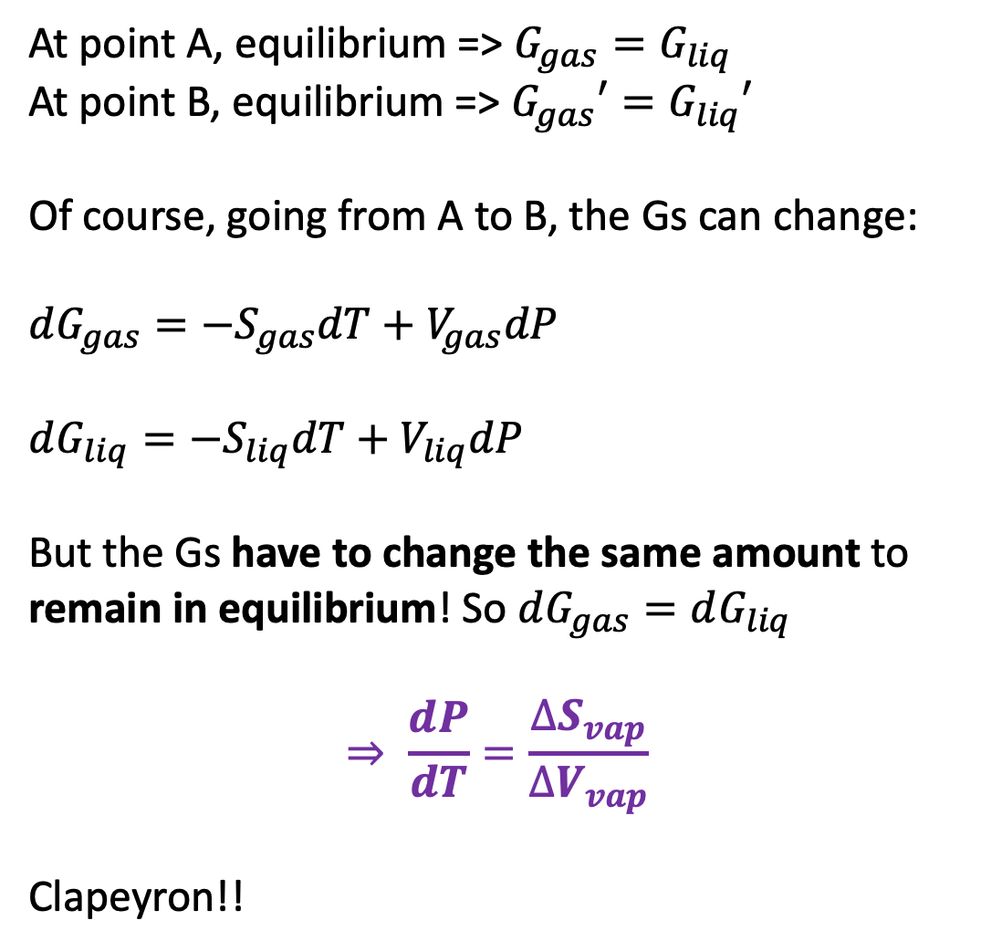
4. Equilibrium and connection to Clapeyron
At point A, equilibrium => $G_{gas}=G_{liq}$
At point B, equilibrium => $G_{gas}′=G_{liq}′$
Of course, going from A to B, the Gs can change:
$dG_{gas}=−S_{gas}dT+V_{gas}dP$
$dG_{liq}=−S_{liq}dT+V_{liq}dP$
But the Gs have to change the same amount to remain in equilibrium! So $dG_{gas}=dG_{liq}$
$$⇒ \frac{dP}{dT}=\frac{∆S_{vap}}{∆V_{vap}}$$
Clapeyron!!
A
B
Liquid
A
Gas
B

Slide 15
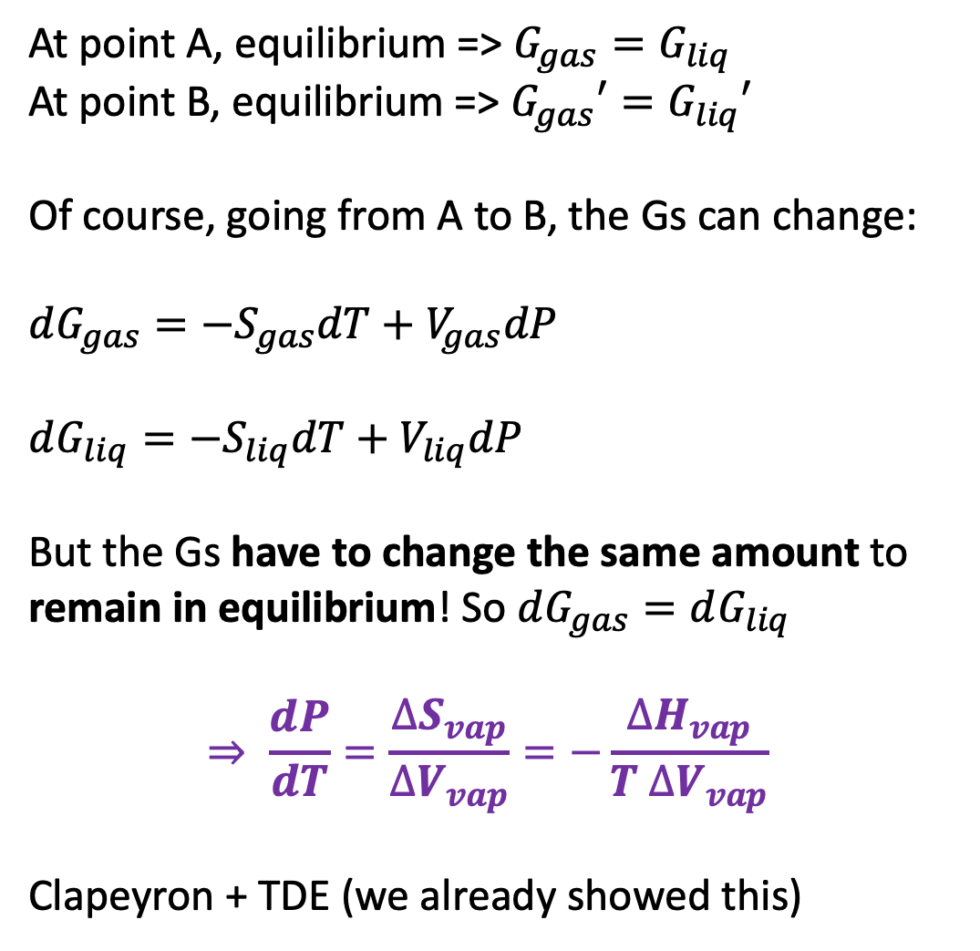
4. Equilibrium and connection to Clapeyron
At point A, equilibrium => $G_{gas}=G_{liq}$
At point B, equilibrium => $G_{gas}′=G_{liq}′$
Of course, going from A to B, the Gs can change:
$dG_{gas}=−S_{gas}dT+V_{gas}dP$
$dG_{liq}=−S_{liq}dT+V_{liq}dP$
But the Gs have to change the same amount to remain in equilibrium! So $dG_{gas}=dG_{liq}$
$$⇒ \frac{dP}{dT}=\frac{∆S_{vap}}{∆V_{vap}}=−\frac{∆H_{vap}}{T ∆V_{vap}}$$
Clapeyron + TDE (we already showed this)
A
B
Liquid
A
Gas
B

Slide 16


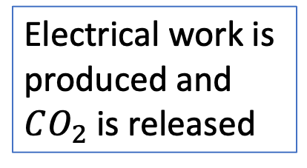
5. Thermodynamics of fossil fuel burning: big picture
$$C\left(s\right)+O_{2}\left(g\right)→CO_{2}\left(g\right)$$
Electrical work is produced and $CO_{2}$ is released
Heat goes in
Furnace

Slide 17
5. Thermodynamics of fossil fuel burning: big picture
Electrical work is produced and $CO_{2}$ is released
Heat goes in
Somebody in the future will have to collect (concentrate) this in order to react it with rock, whatever
Furnace

Slide 18

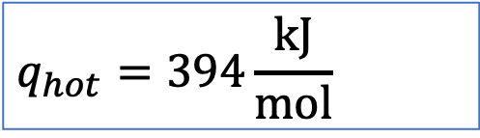
5. Thermodynamics of fossil fuel burning: heat from $∆H_{rxn}$ (products-reactants)
$$q_{hot}=394\frac{kJ}{mol}$$
Furnace

Slide 19
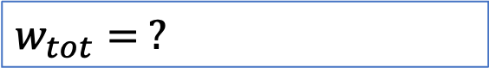
5. Thermodynamics of fossil fuel burning: work produced
$$q_{hot}=394\frac{kJ}{mol}$$
$$w_{tot}= ?$$
Furnace

Slide 20
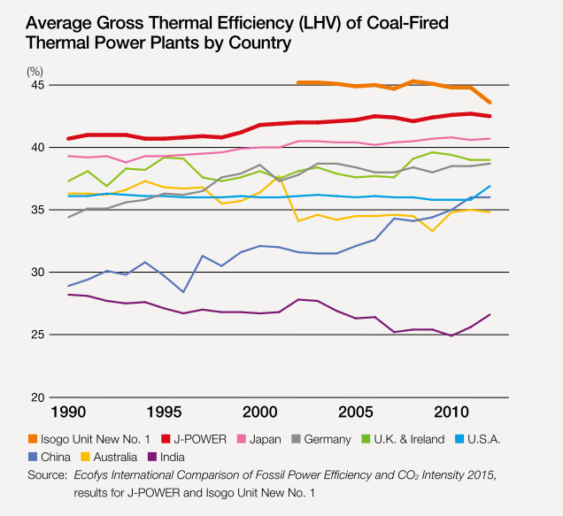
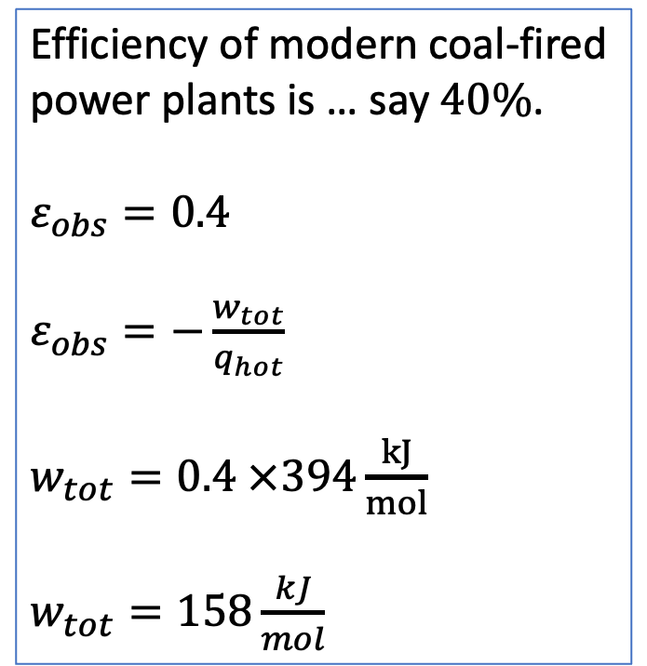
5. Thermodynamics of fossil fuel burning: work produced
Efficiency of modern coal-fired power plants is … say $40\%$.
$ε_{obs}=0.4$
$ε_{obs}=−\frac{w_{tot}}{q_{hot}}$
$w_{tot}=0.4 ×394\frac{kJ}{mol}$
$w_{tot}=158\frac{kJ}{mol}$
https://2.bp.blogspot.com/-PR4a3JB5N8Y/WQ6-hqsdQPI/AAAAAAAAA2o/F2QTjpxyVxsPwRAPEabYAvnwOa3uHnS6ACLcB/s1600/Coal-power-plants-thermal-efficiency.png

Slide 21
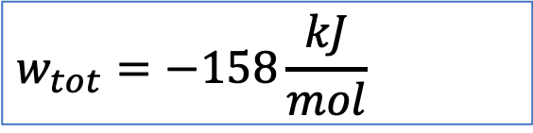
5. Thermodynamics of fossil fuel burning: work produced
$$q_{hot}=394\frac{kJ}{mol}$$
$$w_{tot}=−158\frac{kJ}{mol}$$
Furnace

Slide 22

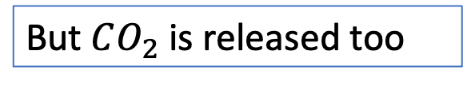
5. Thermodynamics of fossil fuel burning: work required to retrieve from the atmosphere
$$C_{atm}=0.00042 bar$$
$$q_{hot}=394\frac{kJ}{mol}$$
But $CO_{2}$ is released too
$$w_{tot}=−158\frac{kJ}{mol}$$
Furnace

Slide 23
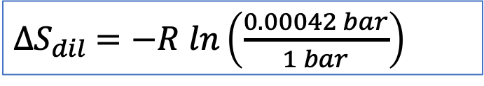
5. Thermodynamics of fossil fuel burning: work required to retrieve from the atmosphere
$$C_{atm}=0.00042 bar$$
$$q_{hot}=394\frac{kJ}{mol}$$
But $CO_{2}$ is released too
$$w_{tot}=−158\frac{kJ}{mol}$$
$∆S_{dil}$ $=−R ln\left(\frac{0.00042 bar}{1 bar}\right)$
Furnace

Slide 24
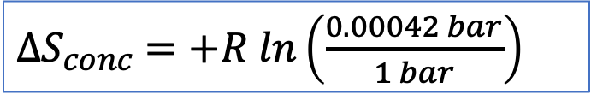
5. Thermodynamics of fossil fuel burning: work required to retrieve from the atmosphere
$$C_{atm}=0.00042 bar$$
$$q_{hot}=394\frac{kJ}{mol}$$
But $CO_{2}$ is released too
$$w_{tot}=−158\frac{kJ}{mol}$$
$∆S_{conc}$ $=+R ln\left(\frac{0.00042 bar}{1 bar}\right)$
Furnace

Slide 25
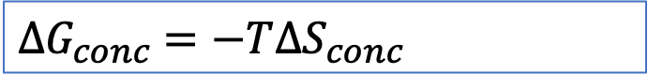
5. Thermodynamics of fossil fuel burning: work required to retrieve from the atmosphere
$$C_{atm}=0.00042 bar$$
$$q_{hot}=394\frac{kJ}{mol}$$
But $CO_{2}$ is released too
$$w_{tot}=−158\frac{kJ}{mol}$$
$∆G_{conc}$ $=−T∆S_{conc}$
Furnace

Slide 26
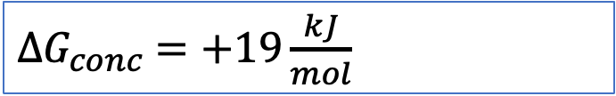
5. Thermodynamics of fossil fuel burning: work required to retrieve from the atmosphere
$$C_{atm}=0.00042 bar$$
$$q_{hot}=394\frac{kJ}{mol}$$
But $CO_{2}$ is released too
$$w_{tot}=−158\frac{kJ}{mol}$$
$∆G_{conc}$ $=+19\frac{kJ}{mol}$
Furnace

Slide 27
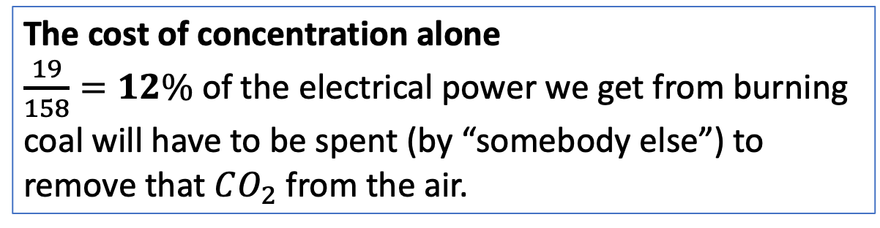
5. Thermodynamics of fossil fuel burning: work required to retrieve from the atmosphere
$$C_{atm}=0.00042 bar$$
$$q_{hot}=394\frac{kJ}{mol}$$
But $CO_{2}$ is released too
$$w_{tot}=−158\frac{kJ}{mol}$$
The cost of concentration alone
$\frac{19}{158}=12\%$ of the electrical power we get from burning coal will have to be spent (by “somebody else”) to remove that $CO_{2}$ from the air.
$∆G_{conc}$ $=+19\frac{kJ}{mol}$
Furnace

Slide 28
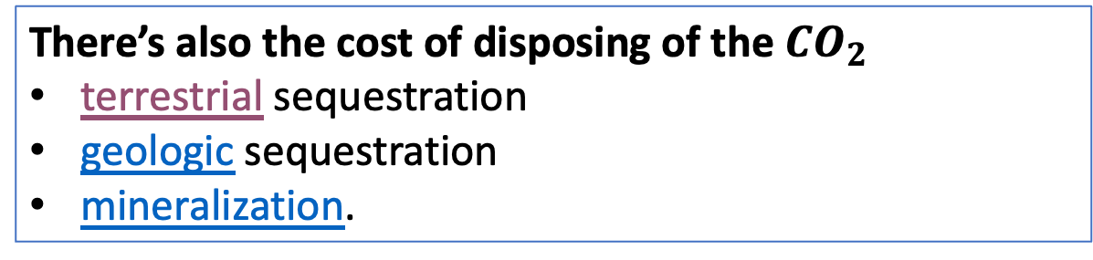
5. Thermodynamics of fossil fuel burning: work required to retrieve from the atmosphere
$$C_{atm}=0.00042 bar$$
$$q_{hot}=394\frac{kJ}{mol}$$
But $CO_{2}$ is released too
$$w_{tot}=−158\frac{kJ}{mol}$$
There’s also the cost of disposing of the $CO_{2}$
terrestrial sequestration
geologic sequestration
mineralization.
$∆G_{conc}$ $=+19\frac{kJ}{mol}$
Furnace
Disposal
?

Slide 29
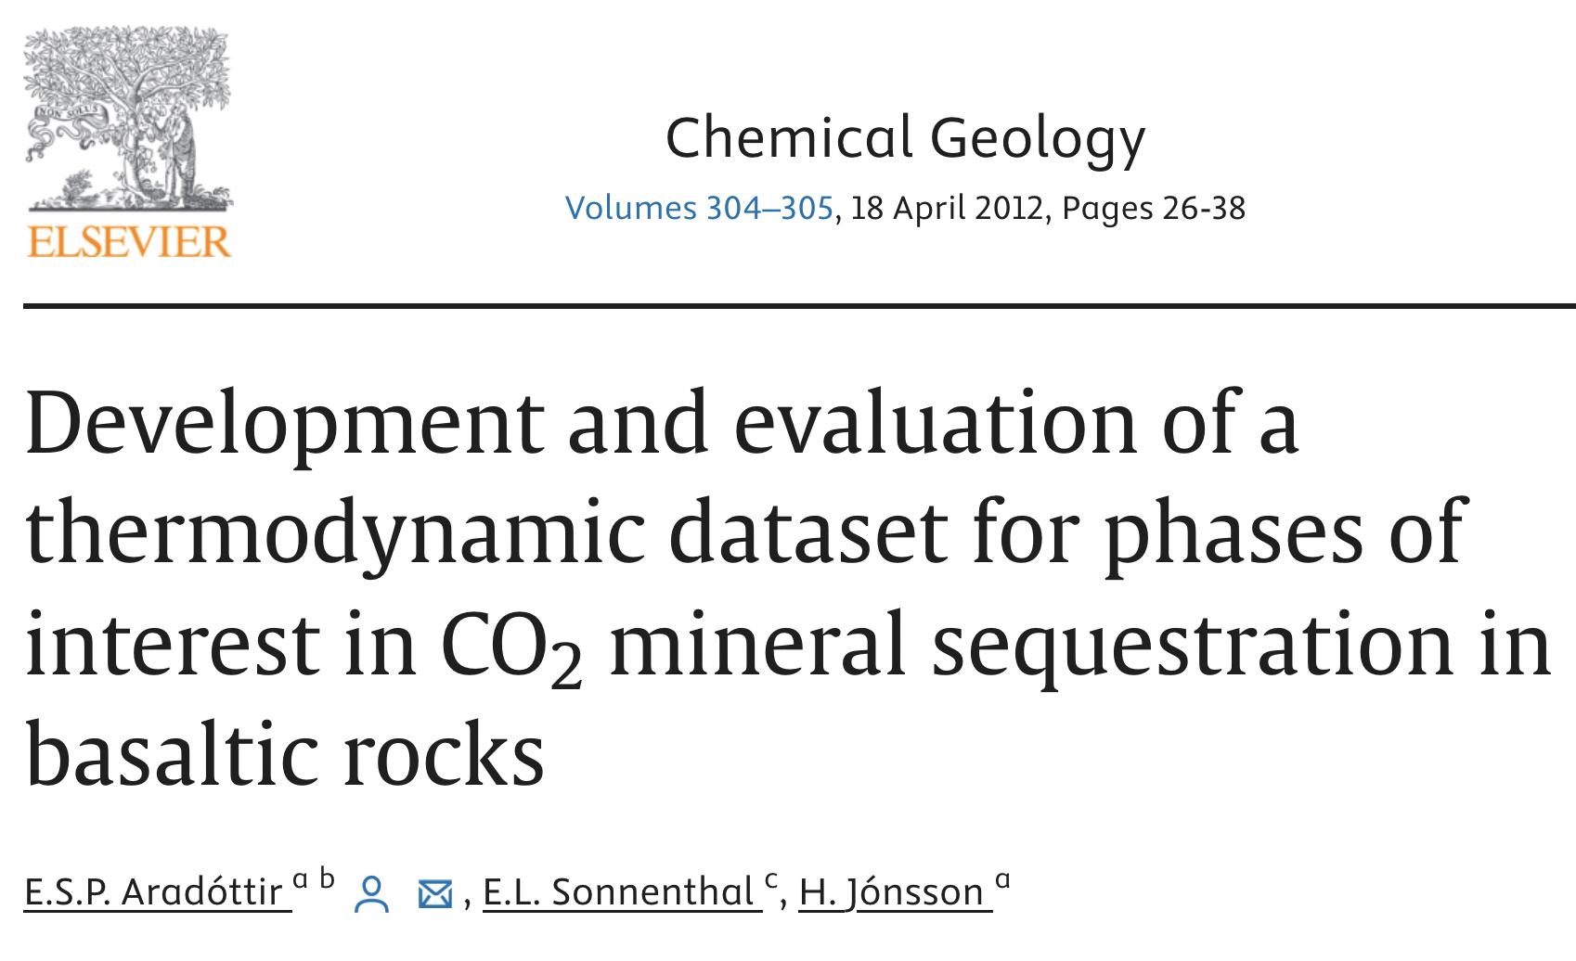
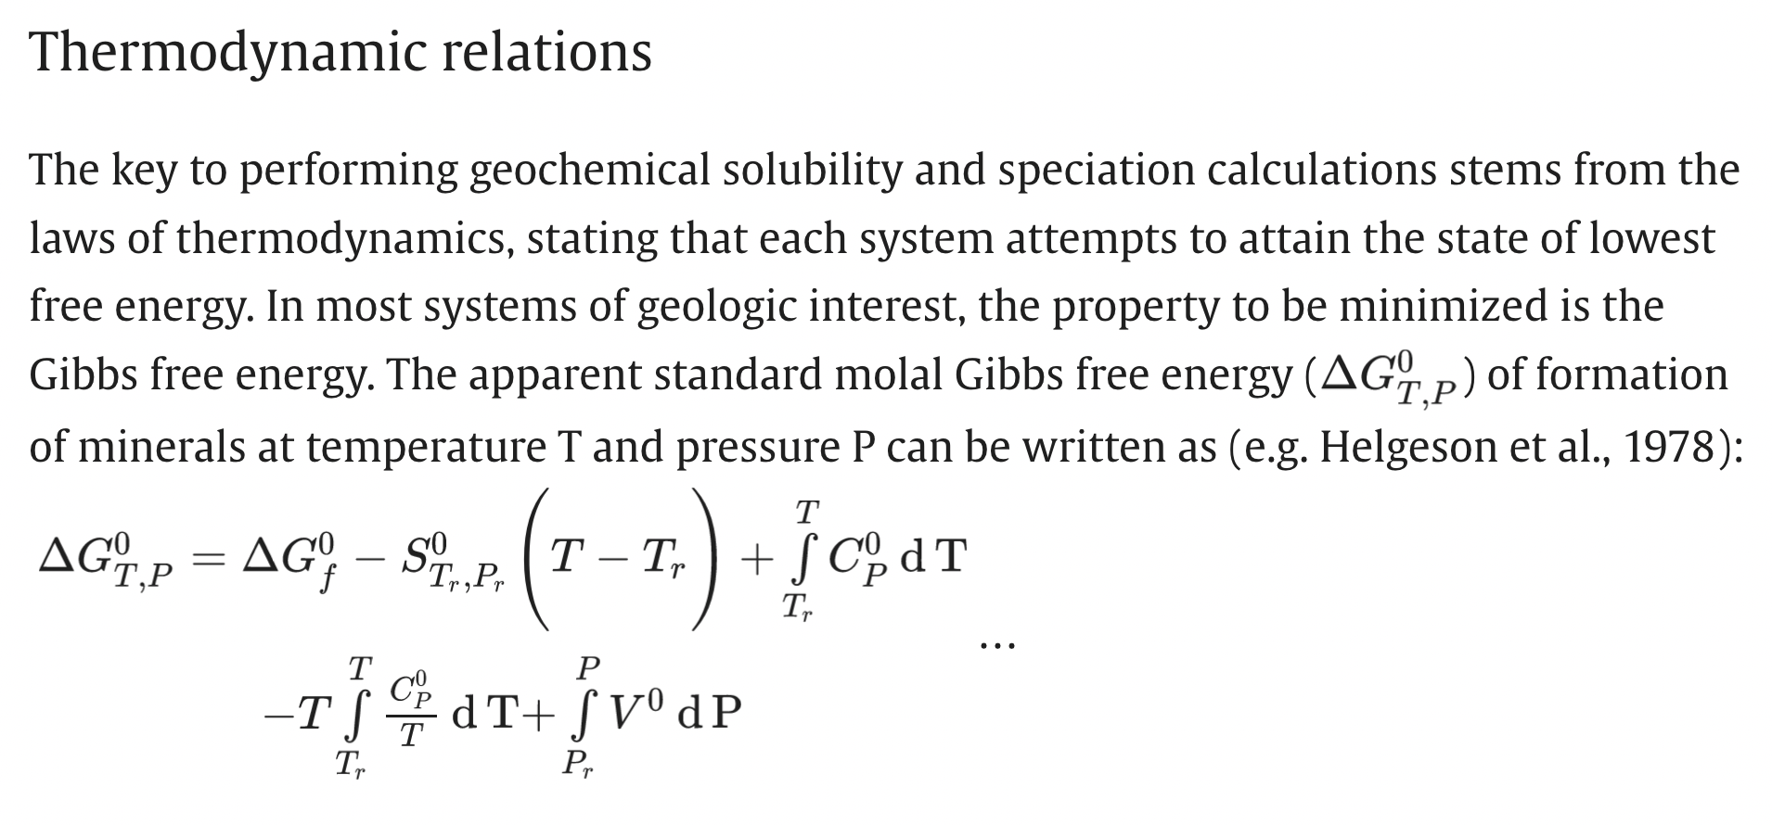
5. Thermodynamics of fossil fuel burning: Thermodynamics of disposal

